Slide 1
CS 484
Introduction to Machine Learning
Week 3, February 4, 2021
Spring Semester 2021

Slide 2
Week 3: Association Rule Learner
Association Rule Discovery
Bayes’ Theorem
Market Basket Example
Chapter 3 of the Machine Learning book

Slide 3
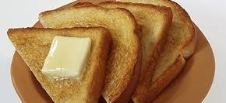
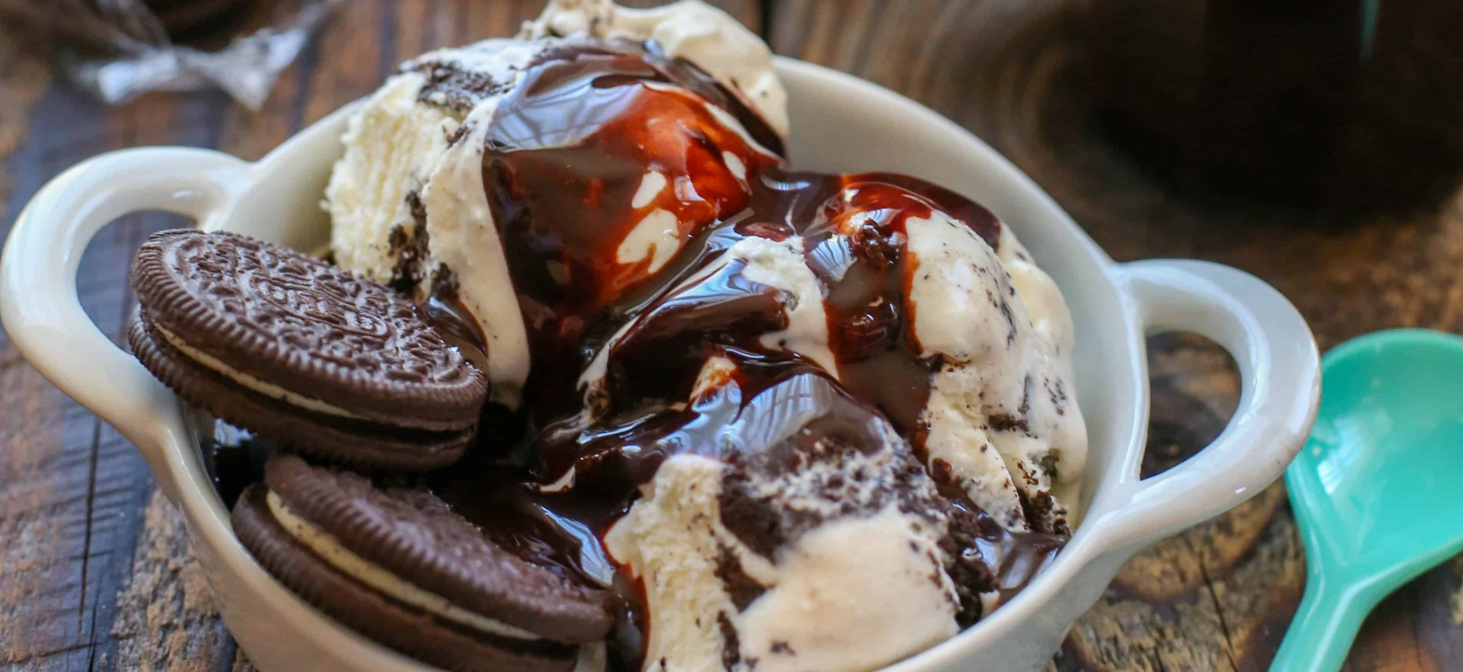
Association Rule Discovery Motivated
What did you buy in your most recent grocery trip?
Did you buy only one item?
Do you notice that there are items that you will very likely buy together?

Slide 4
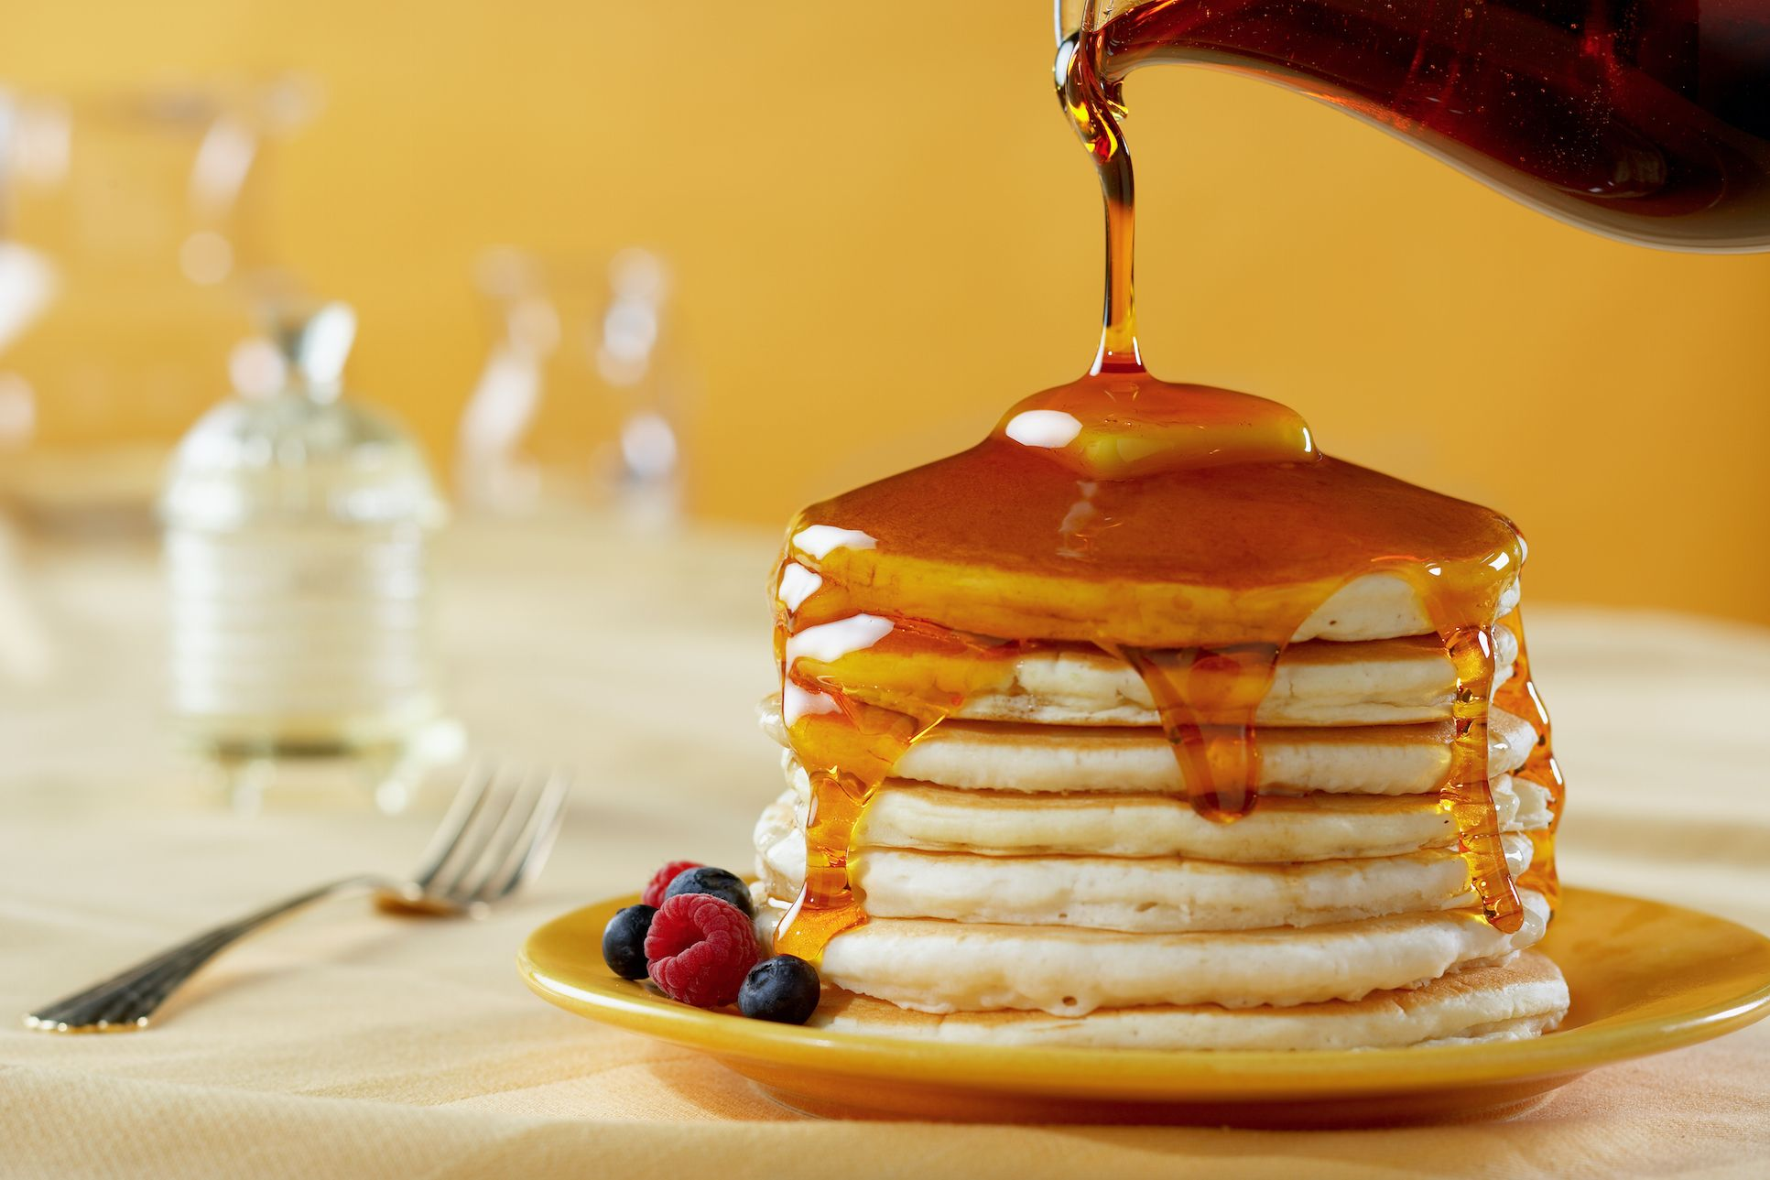
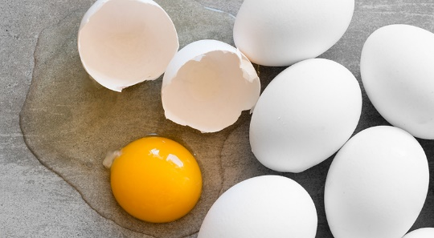
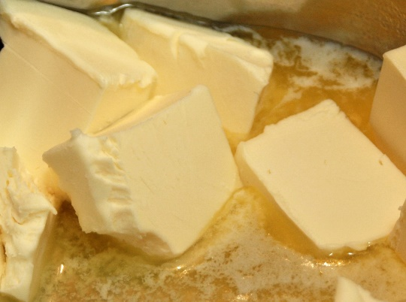
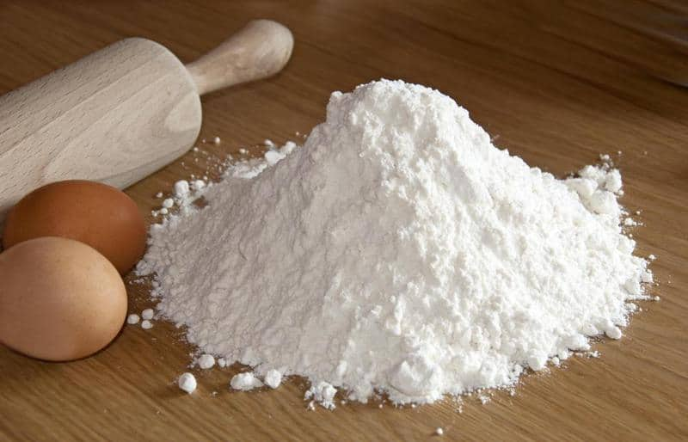
Making Pancake Breakfast for Mother’s Day

Slide 5
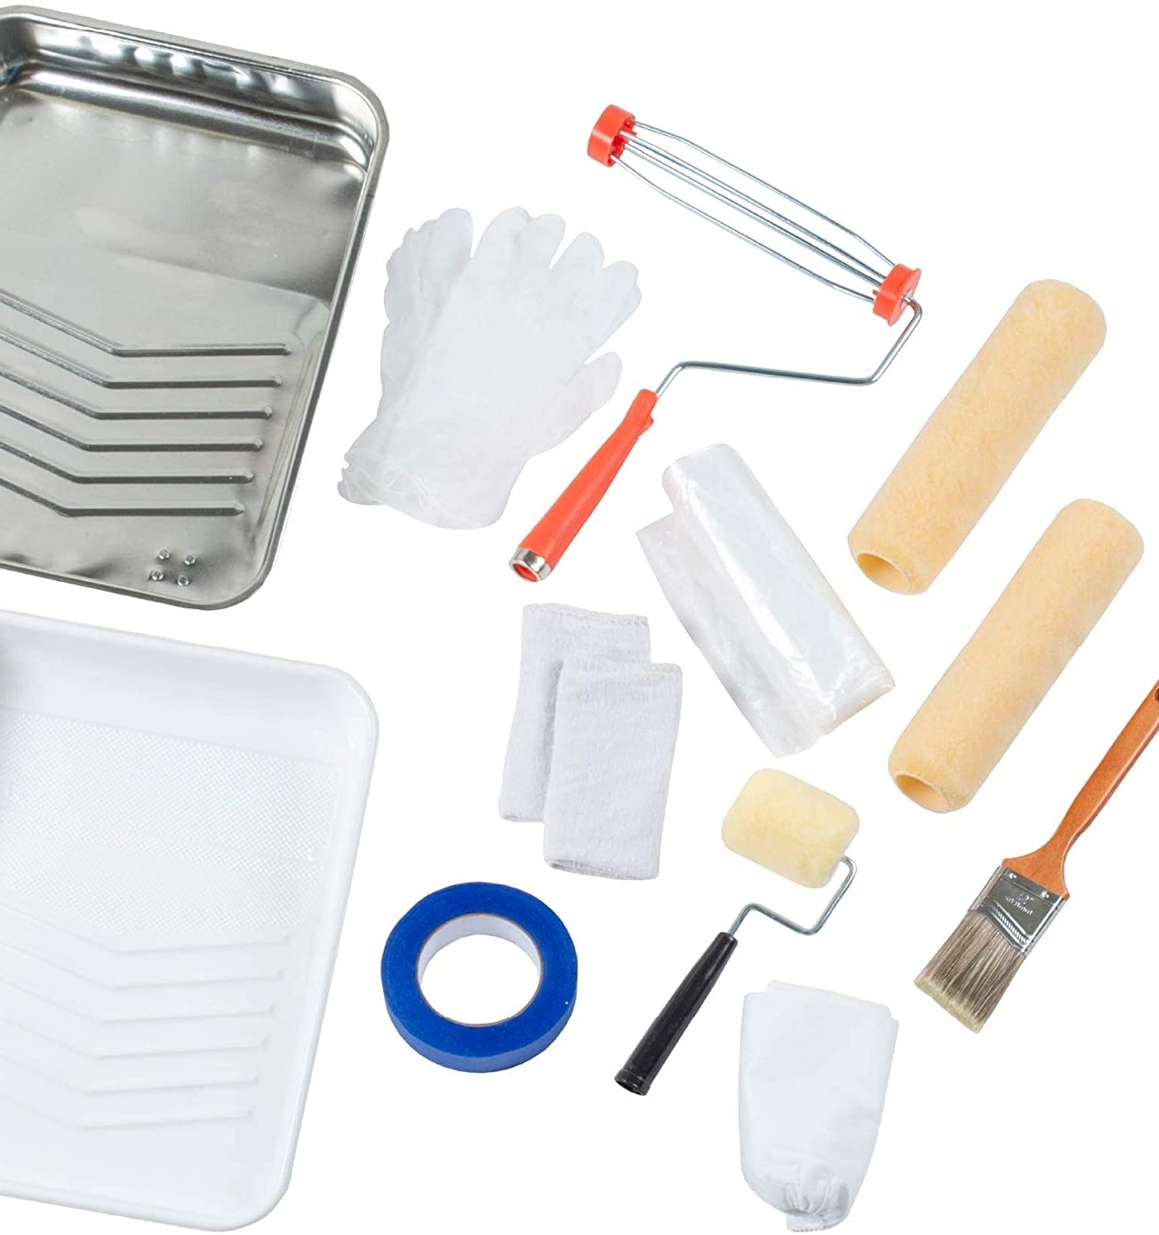
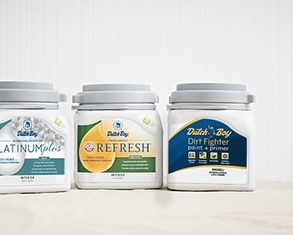

Painting a Room for Someone Special

Slide 6
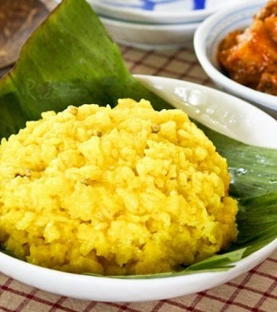
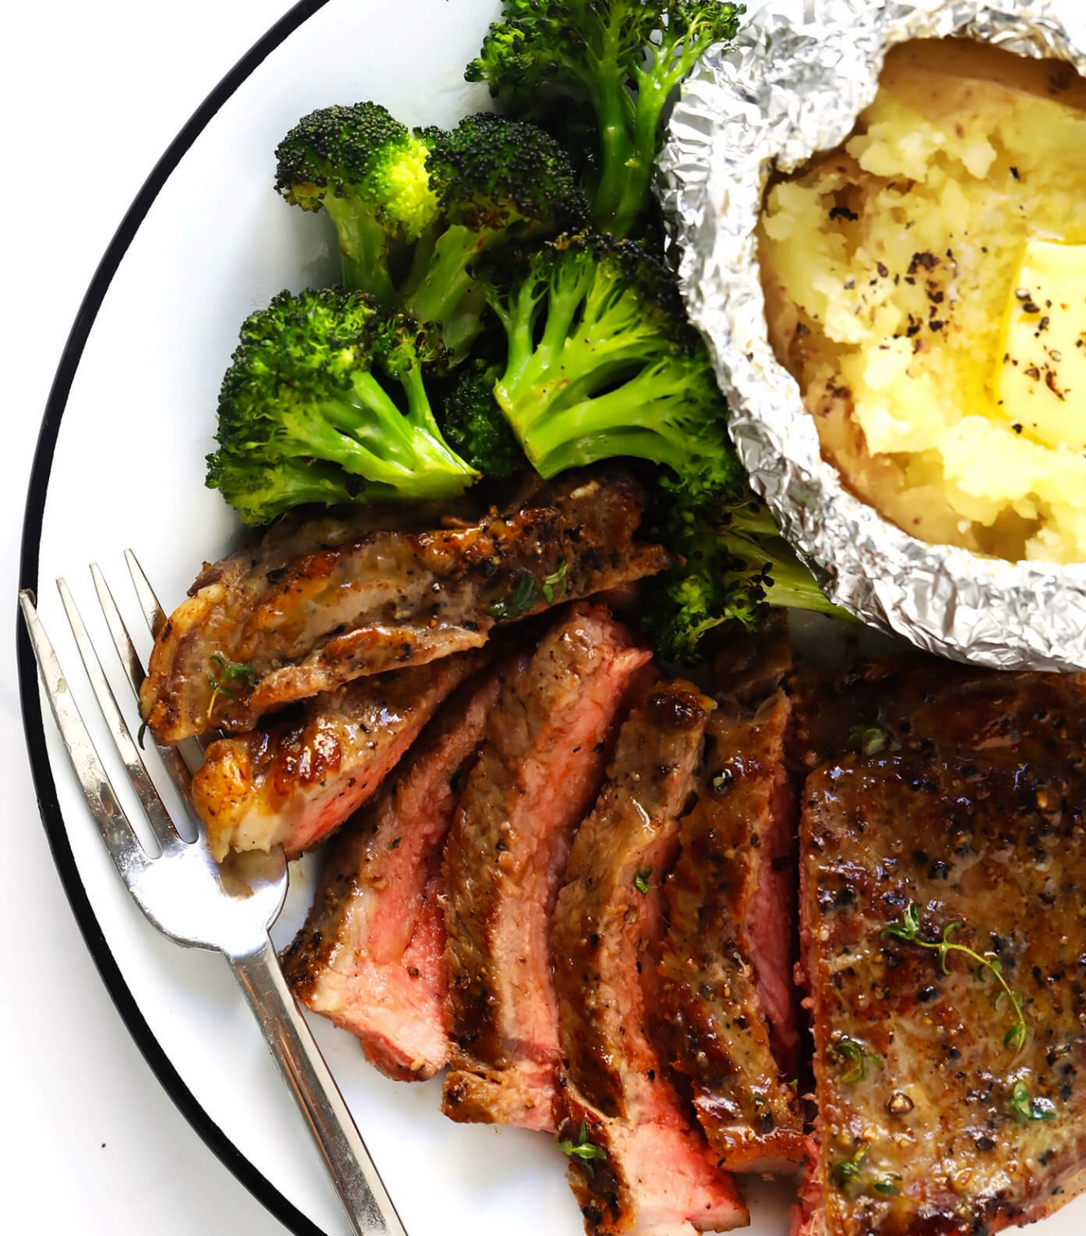
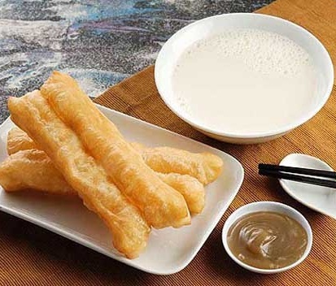
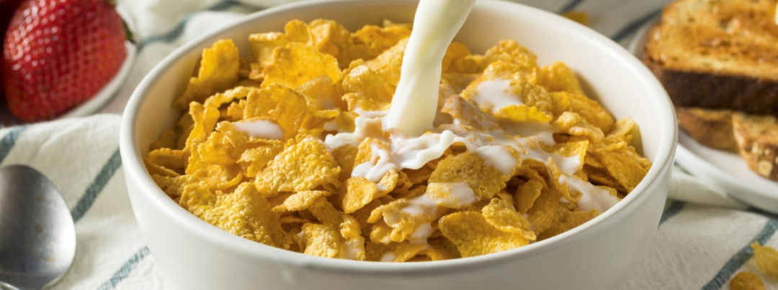
Weekly Trip for Daily Staple

Slide 7

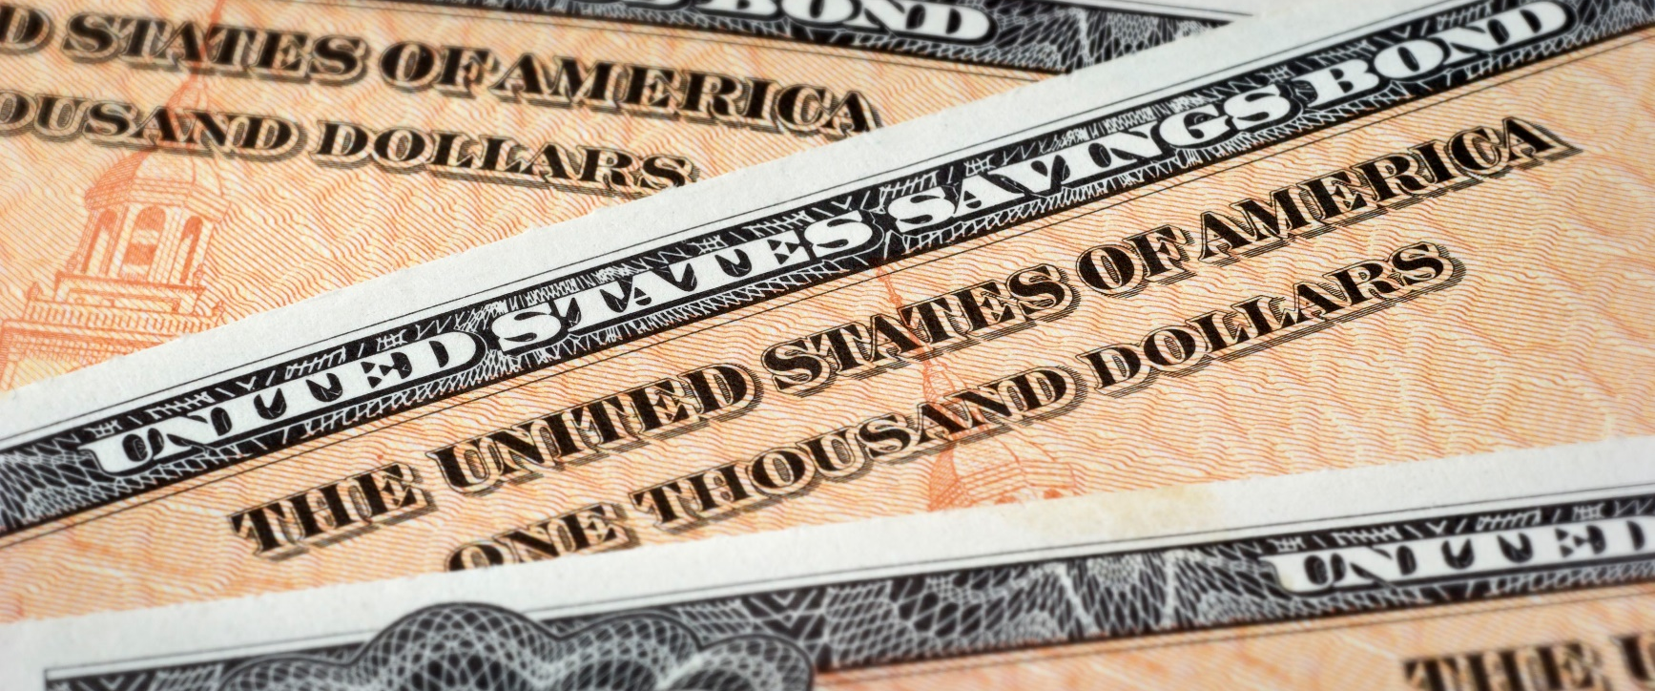

Personalize Investment Portfolio

Slide 8
Association Rule Discovery Motivated
Identifying credible associations enable merchants make decisions
Which coupons to distribute?
When to put a product on sale?
What products are put together on the shelf?

Slide 9
Association Rule Discovery Quick Overview
Definition: The identification of items that occur together in a typical event or record (commonly called a transaction)
Other Names: Market Basket Analysis (MBA)
Data Source: Point-of-Sale transaction processing systems
Data Type: All items as categorical data
Sufficient Statistic: The frequency counts of the number of times items occur alone and in combination

Slide 10
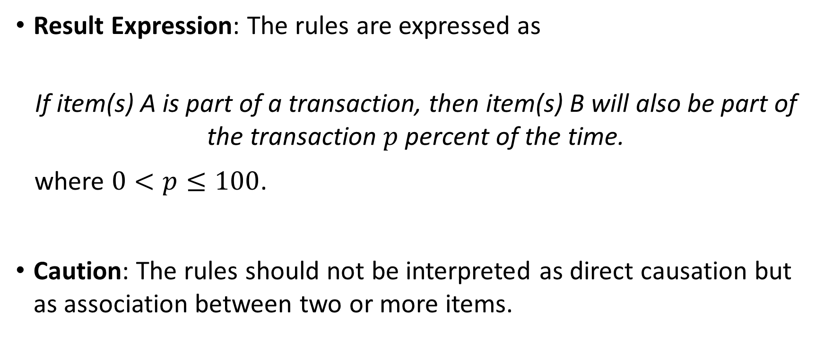
Association Rule Discovery Quick Overview
Result Expression: The rules are expressed as
If item(s) A is part of a transaction, then item(s) B will also be part of the transaction $p$ percent of the time.
where $0<p≤100$.
Caution: The rules should not be interpreted as direct causation but as association between two or more items.

Slide 11
Examples of Association Rule
80% of shoppers who buy ice-cream also purchase ice-cream cones.
85% of the “do-it-yourselfers” also buy roller covers IF they bought latex paint.
40% of investors who hold an equity index fund will have a bond fund in their portfolio.
60% of students who took Machine Learning and Data Mining also register for Deep Learning.

Slide 12
Association Rule Discovery History
Proposed by Agrawal, Imielinski, and Swami in their 1993 paper
“Mining Association Rules between Sets of Items in Large Databases”, Proceedings of the 1993 ACM SIGMOD Conference Washington DC, May 1993
ACM SIGMOD: Association for Computing Machinery Special Interest Group on Management Of Data
Initially used for Market Basket analysis to find how items purchased by customers are related
Most algorithms are related to the Apriori algorithm due to Agrawal and Srikant 1994 paper
“Fast Algorithms for Mining Association Rules”, Proceedings of the 20th VLDB Conference Santiago, Chile, 1994
VLDB: Very Large Data Bases

Slide 13

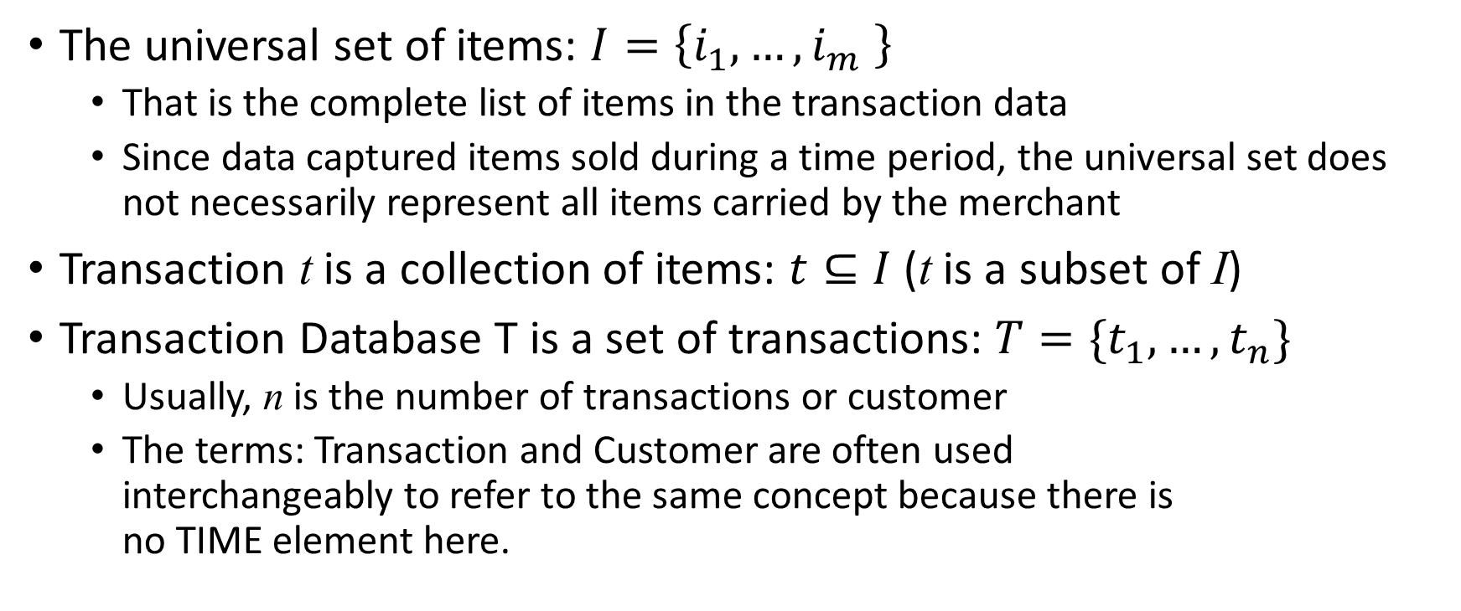
Data for Association Rule Discovery
The universal set of items: $I=\left\{i_{1},…,i_{m} \right\}$
That is the complete list of items in the transaction data
Since data captured items sold during a time period, the universal set does not necessarily represent all items carried by the merchant
Transaction t is a collection of items: $t⊆I$ (t is a subset of I)
Transaction Database T is a set of transactions: $T=\{t_{1},…,t_{n}\}$
Usually, n is the number of transactions or customer
The terms: Transaction and Customer are often used interchangeably to refer to the same concept because there is no TIME element here.

Slide 14
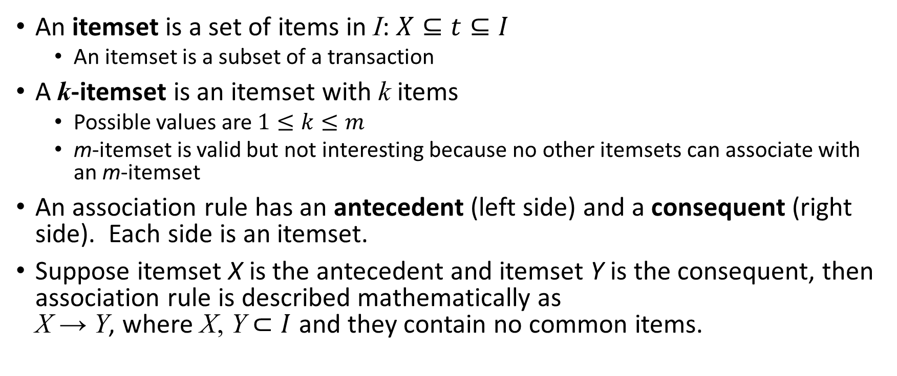
Association Rules
An itemset is a set of items in I: $X⊆t⊆I$
An itemset is a subset of a transaction
A k-itemset is an itemset with k items
Possible values are $1≤k≤m$
m-itemset is valid but not interesting because no other itemsets can associate with an m-itemset
An association rule has an antecedent (left side) and a consequent (right side). Each side is an itemset.
Suppose itemset X is the antecedent and itemset Y is the consequent, then association rule is described mathematically as X → Y, where X, Y $⊂I$ and they contain no common items.

Slide 15
Measuring Association Rules
Support
Confidence
Expected Confidence
Lift
Leverage
Conviction

Slide 16
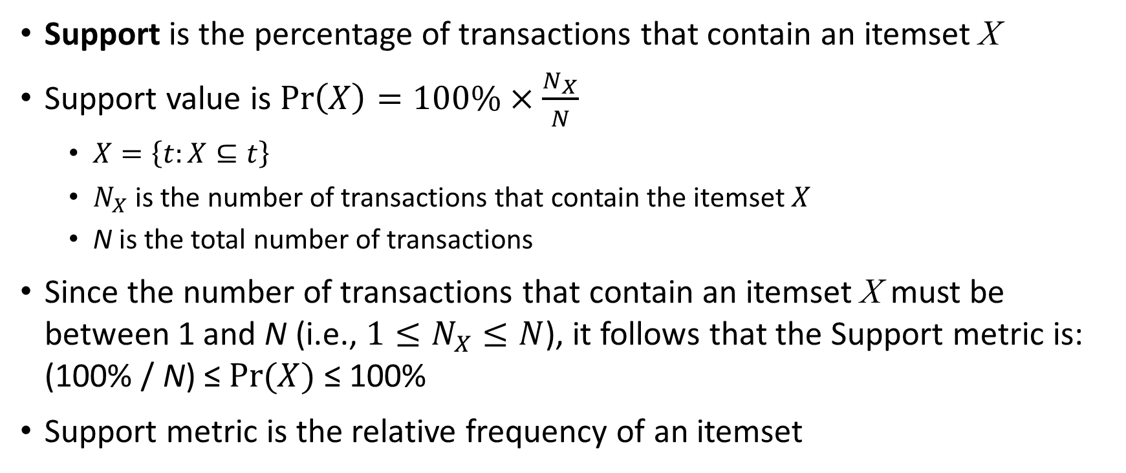
Association Rules: Support Metric
Support is the percentage of transactions that contain an itemset X
Support value is $Pr\left(X\right)=100\%×\frac{N_{X}}{N}$
$X=\left\{t:X⊆t\right\}$
$N_{X}$ is the number of transactions that contain the itemset $X$
N is the total number of transactions
Since the number of transactions that contain an itemset X must be between 1 and N (i.e., $1≤N_{X}≤N$), it follows that the Support metric is: (100% / N) ≤ $Pr(X)$ ≤ 100%
Support metric is the relative frequency of an itemset

Slide 17
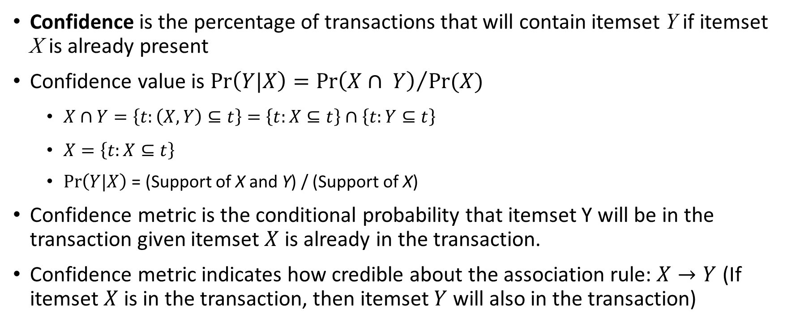
Association Rules: Confidence Metric
Confidence is the percentage of transactions that will contain itemset Y if itemset X is already present
Confidence value is $Pr\left(Y|X\right)={Pr\left(X∩ Y\right)}/{Pr(X)}$
$X∩Y=\left\{t:\left(X,Y\right)⊆t\right\}=\left\{t:X⊆t\right\}∩\left\{t:Y⊆t\right\}$
$X=\left\{t:X⊆t\right\}$
$Pr\left(Y|X\right)$ = (Support of X and Y) / (Support of X)
Confidence metric is the conditional probability that itemset Y will be in the transaction given itemset $X$ is already in the transaction.
Confidence metric indicates how credible about the association rule: $X→Y$ (If itemset $X$ is in the transaction, then itemset $Y$ will also in the transaction)

Slide 18
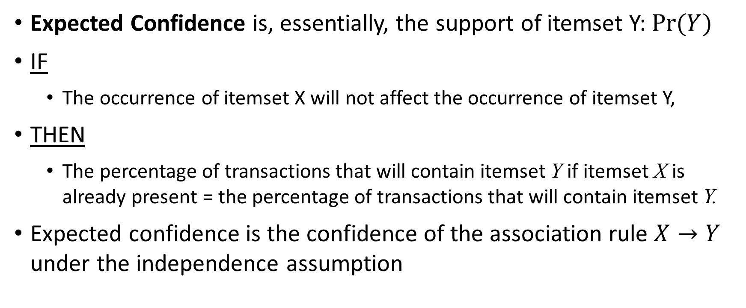
Association Rules: Expected Confidence Metric
Expected Confidence is, essentially, the support of itemset Y: $Pr(Y)$
IF
The occurrence of itemset X will not affect the occurrence of itemset Y,
THEN
The percentage of transactions that will contain itemset Y if itemset X is already present = the percentage of transactions that will contain itemset Y.
Expected confidence is the confidence of the association rule $X→Y$ under the independence assumption

Slide 19
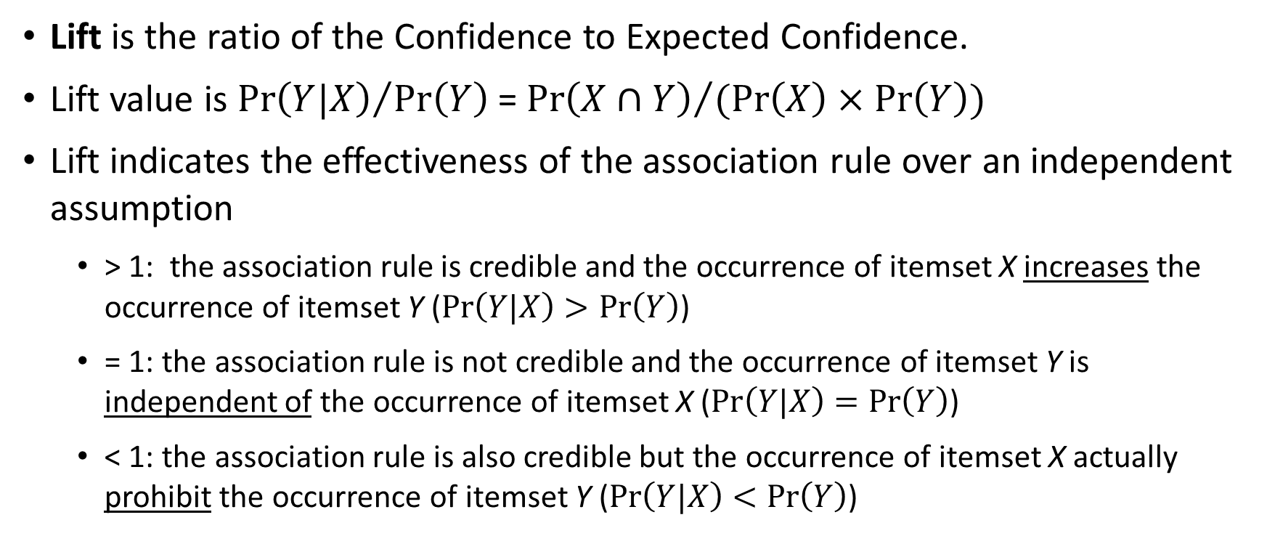
Association Rules: Lift Metric
Lift is the ratio of the Confidence to Expected Confidence.
Lift value is ${Pr\left(Y|X\right)}/{Pr\left(Y\right)}$ = ${Pr\left(X∩Y\right)}/{(Pr\left(X\right)×Pr\left(Y\right))}$
Lift indicates the effectiveness of the association rule over an independent assumption
> 1: the association rule is credible and the occurrence of itemset X increases the occurrence of itemset Y ($Pr\left(Y|X\right)>Pr\left(Y\right)$)
= 1: the association rule is not credible and the occurrence of itemset Y is independent of the occurrence of itemset X ($Pr\left(Y|X\right)=Pr\left(Y\right)$)
< 1: the association rule is also credible but the occurrence of itemset X actually prohibit the occurrence of itemset Y ($Pr\left(Y|X\right)<Pr\left(Y\right)$)

Slide 20
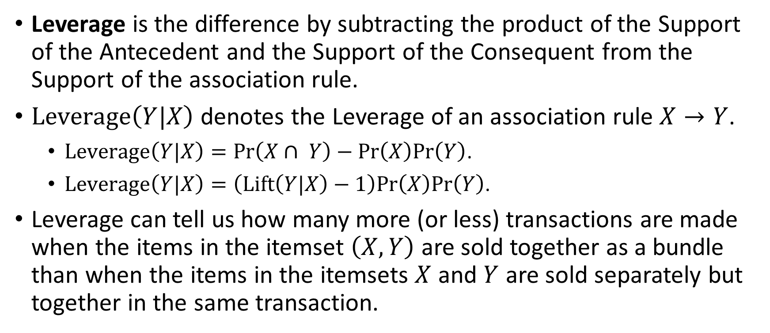
Association Rules: Leverage Metric
Leverage is the difference by subtracting the product of the Support of the Antecedent and the Support of the Consequent from the Support of the association rule.
$Leverage\left(Y|X\right)$ denotes the Leverage of an association rule $X→Y$.
$Leverage\left(Y|X\right)=Pr\left(X∩ Y\right)−Pr\left(X\right)Pr\left(Y\right)$.
$Leverage\left(Y|X\right)=\left(Lift\left(Y|X\right)−1\right)Pr\left(X\right)Pr\left(Y\right)$.
Leverage can tell us how many more (or less) transactions are made when the items in the itemset $\left(X,Y\right)$ are sold together as a bundle than when the items in the itemsets $X$ and $Y$ are sold separately but together in the same transaction.

Slide 21
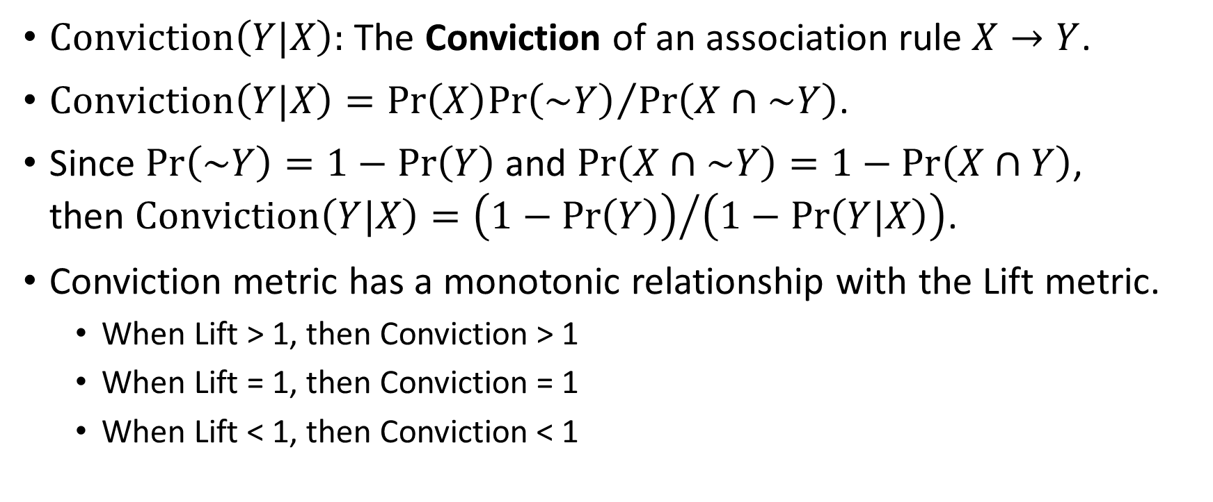
Association Rules: Conviction Metric
$Conviction\left(Y|X\right):$ The Conviction of an association rule $X→Y$.
$Conviction\left(Y|X\right)={Pr\left(X\right)Pr\left(\sim Y\right)}/{Pr\left(X∩\sim Y\right)}$.
Since $Pr\left(\sim Y\right)=1−Pr\left(Y\right)$ and $Pr\left(X∩\sim Y\right)=1−Pr\left(X∩Y\right)$, then $Conviction\left(Y|X\right)={\left(1−Pr\left(Y\right)\right)}/{\left(1−Pr\left(Y|X\right)\right)}$.
Conviction metric has a monotonic relationship with the Lift metric.
When Lift > 1, then Conviction > 1
When Lift = 1, then Conviction = 1
When Lift < 1, then Conviction < 1

Slide 22
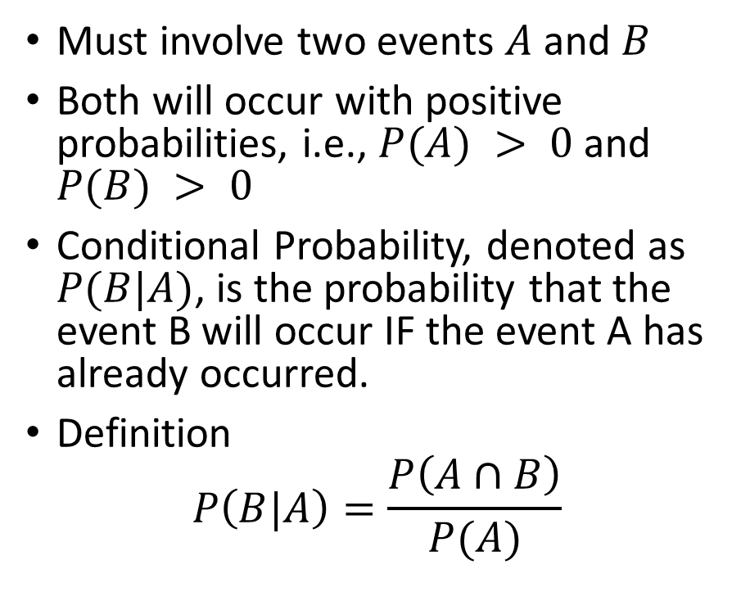
A Few Words On Conditional Probability
Marginal Probability P(B) > 0
Must involve two events $A$ and $B$
Both will occur with positive probabilities, i.e., $P(A) > 0$ and $P(B) > 0$
Conditional Probability, denoted as $P(B|A)$, is the probability that the event B will occur IF the event A has already occurred.
Definition
$$P\left(B|A\right)=\frac{P\left(A∩B\right)}{P(A)}$$
Event A
Event B
Marginal Probability P(A) > 0

Slide 23
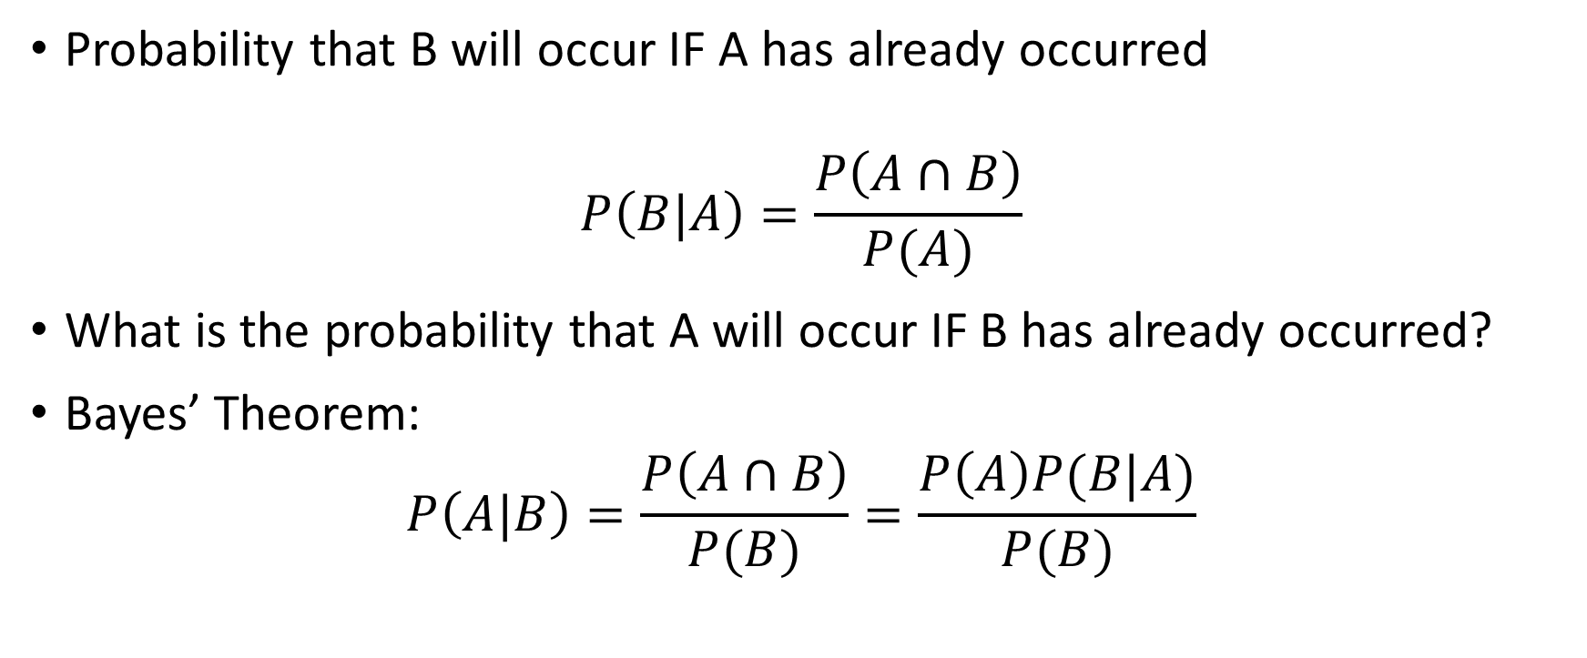
Bayes’ Theorem
Probability that B will occur IF A has already occurred
$$P\left(B|A\right)=\frac{P\left(A∩B\right)}{P(A)}$$
What is the probability that A will occur IF B has already occurred?
Bayes’ Theorem:
$$P\left(A|B\right)=\frac{P\left(A∩B\right)}{P(B)}=\frac{P\left(A\right)P(B|A)}{P(B)}$$

Slide 24
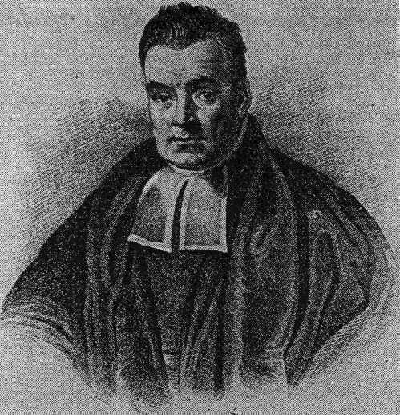
The Term “Bayesian”
The term comes from the widespread usage of Bayes’ theorem
Named after the Reverend Thomas Bayes (1702 – 1761), an eighteenth-century English statistician, philosopher, and Presbyterian minister.
Rev. Bayes was interested in solving the question of inverse probability: after observing a collection of events, what is the probability of the occurrence of a single event?

Slide 25
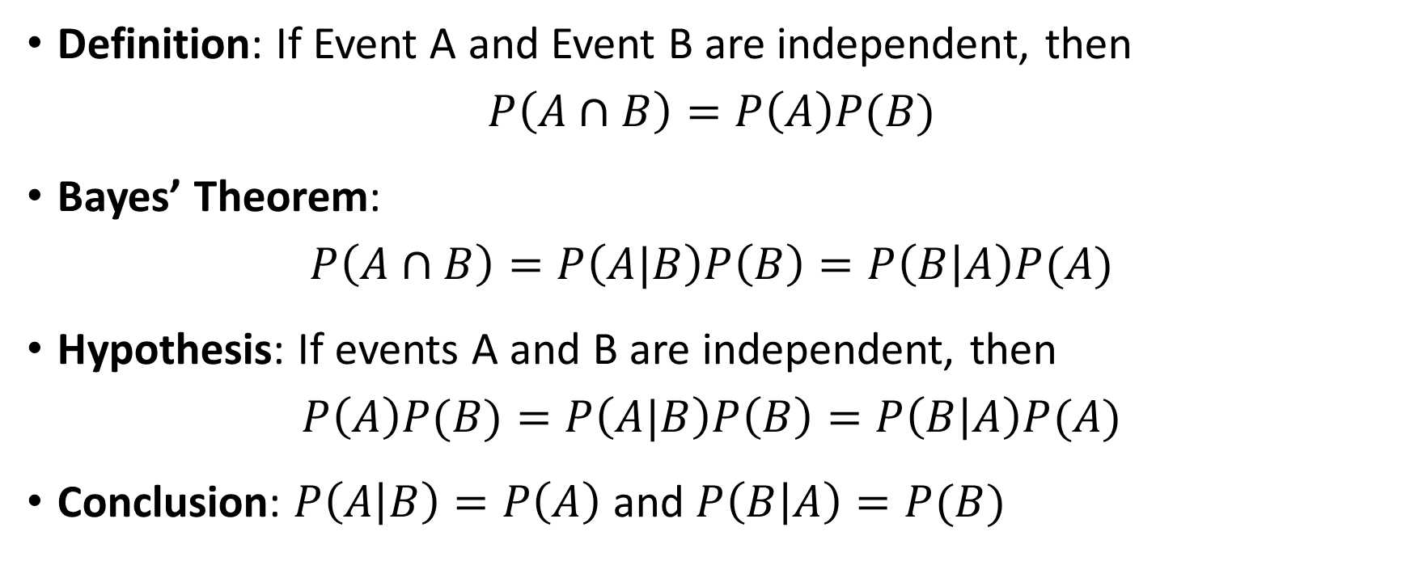
Bayesian Theorem - Independence
Definition: If Event A and Event B are independent, then
$$P\left(A∩B\right)=P\left(A\right)P(B)$$
Bayes’ Theorem:
$$P\left(A∩B\right)=P\left(A|B\right)P\left(B\right)=P\left(B | A\right)P(A)$$
Hypothesis: If events A and B are independent, then
$$P\left(A\right)P(B)=P\left(A|B\right)P\left(B\right)=P\left(B | A\right)P(A)$$
Conclusion: $P\left(A | B\right)=P\left(A\right)$ and $P\left(B | A\right)=P(B)$

Slide 26
Bayes’ Theorem - Independence
IF Event A and Event B are independent
THEN knowing the outcome of Event A DOES NOT help us know the outcome of Event B, and vice versa

Slide 27
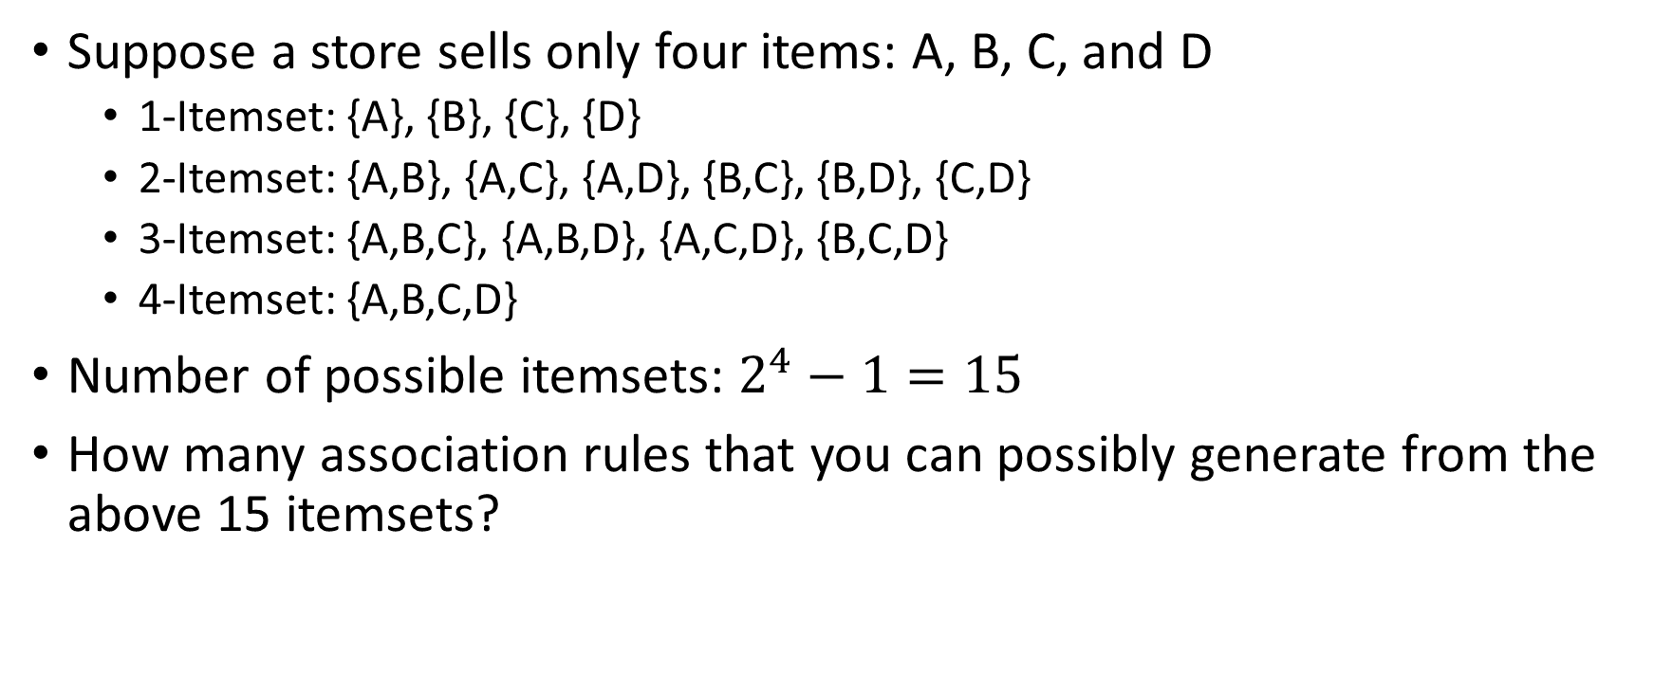
A Toy Example of Association Rules
Suppose a store sells only four items: A, B, C, and D
1-Itemset: {A}, {B}, {C}, {D}
2-Itemset: {A,B}, {A,C}, {A,D}, {B,C}, {B,D}, {C,D}
3-Itemset: {A,B,C}, {A,B,D}, {A,C,D}, {B,C,D}
4-Itemset: {A,B,C,D}
Number of possible itemsets: $2^{4}−1=15$
How many association rules that you can possibly generate from the above 15 itemsets?

Slide 28
All Association Rules (by Antecedent)
1 | {A} | → | {B} | 15 | {C} | → | {A} | 29 | {A,B} | → | {C} | 41 | {B,D} | → | {A}
2 | {A} | → | {C} | 16 | {C} | → | {B} | 30 | {A,B} | → | {D} | 42 | {B,D} | → | {C}
3 | {A} | → | {D} | 17 | {C} | → | {D} | 31 | {A,B} | → | {C,D} | 43 | {B,D} | → | {A,C}
4 | {A} | → | {B,C} | 18 | {C} | → | {A,B}
5 | {A} | → | {B,D} | 19 | {C} | → | {A,D} | 32 | {A,C} | → | {B} | 44 | {C,D} | → | {A}
6 | {A} | → | {C,D} | 20 | {C} | → | {B,D} | 33 | {A,C} | → | {D} | 45 | {C,D} | → | {B}
7 | {A} | → | {B,C,D} | 21 | {C} | → | {A,B,D} | 34 | {A,C} | → | {B,D} | 46 | {C,D} | → | {A,B}
8 | {B} | → | {A} | 22 | {D} | → | {A} | 35 | {A,D} | → | {B} | 47 | {A,B,C} | → | {D}
9 | {B} | → | {C} | 23 | {D} | → | {B} | 36 | {A,D} | → | {C}
10 | {B} | → | {D} | 24 | {D} | → | {C} | 37 | {A,D} | → | {B,C} | 48 | {A,B,D} | → | {C}
11 | {B} | → | {A,C} | 25 | {D} | → | {A,B}
12 | {B} | → | {A,D} | 26 | {D} | → | {A,C} | 38 | {B,C} | → | {A} | 49 | {A,C,D} | → | {B}
13 | {B} | → | {C,D} | 27 | {D} | → | {B,C} | 39 | {B,C} | → | {D}
14 | {B} | → | {A,C,D} | 28 | {D} | → | {A,B,C} | 40 | {B,C} | → | {A,D} | 50 | {B,C,D} | → | {A}

Slide 29
All Association Rules (by Consequent)
1 | {B} | → | {A} | 15 | {A} | → | {C} | 29 | {C} | → | {A,B} | 41 | {A} | → | {B,D}
2 | {C} | → | {A} | 16 | {B} | → | {C} | 30 | {D} | → | {A,B} | 42 | {C} | → | {B,D}
3 | {D} | → | {A} | 17 | {D} | → | {C} | 31 | {C,D} | → | {A,B} | 43 | {A,C} | → | {B,D}
4 | {B,C} | → | {A} | 18 | {A,B} | → | {C}
5 | {B,D} | → | {A} | 19 | {A,D} | → | {C} | 32 | {B} | → | {A,C} | 44 | {A} | → | {C,D}
6 | {C,D} | → | {A} | 20 | {B,D} | → | {C} | 33 | {D} | → | {A,C} | 45 | {B} | → | {C,D}
7 | {B,C,D} | → | {A} | 21 | {A,B,D} | → | {C} | 34 | {B,D} | → | {A,C} | 46 | {A,B} | → | {C,D}
8 | {A} | → | {B} | 22 | {A} | → | {D} | 35 | {B} | → | {A,D} | 47 | {D} | → | {A,B,C}
9 | {C} | → | {B} | 23 | {B} | → | {D} | 36 | {C} | → | {A,D}
10 | {D} | → | {B} | 24 | {C} | → | {D} | 37 | {B,C} | → | {A,D} | 48 | {C} | → | {A,B,D}
11 | {A,C} | → | {B} | 25 | {A,B} | → | {D}
12 | {A,D} | → | {B} | 26 | {A,C} | → | {D} | 38 | {A} | → | {B,C} | 49 | {B} | → | {A,C,D}
13 | {C,D} | → | {B} | 27 | {B,C} | → | {D} | 39 | {D} | → | {B,C}
14 | {A,C,D} | → | {B} | 28 | {A,B,C} | → | {D} | 40 | {A,D} | → | {B,C} | 50 | {A} | → | {B,C,D}

Slide 30
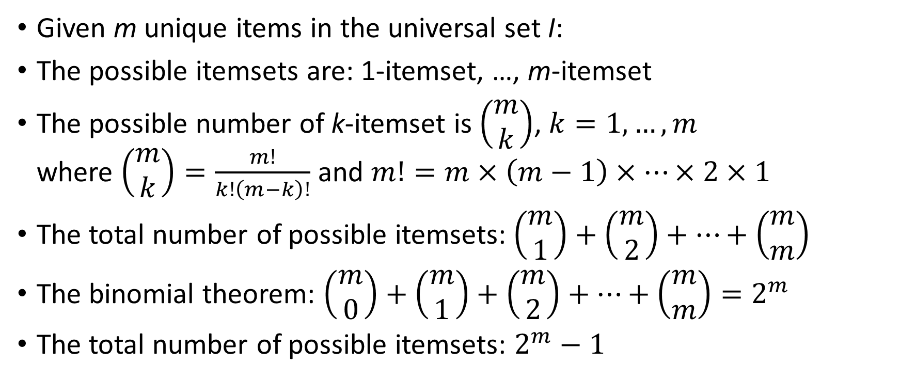
Number of Possible Itemsets
Given m unique items in the universal set I:
The possible itemsets are: 1-itemset, …, m-itemset
The possible number of k-itemset is $\left(\begin{matrix}m \\ k\end{matrix}\right)$, $k=1,…,m$ where $\left(\begin{matrix}m \\ k\end{matrix}\right)=\frac{m!}{k!\left(m−k\right)!}$ and $m!=m×\left(m−1\right)×⋯×2×1$
The total number of possible itemsets:$\left(\begin{matrix}m \\ 1\end{matrix}\right)+\left(\begin{matrix}m \\ 2\end{matrix}\right)+…+\left(\begin{matrix}m \\ m\end{matrix}\right)$
The binomial theorem: $\left(\begin{matrix}m \\ 0\end{matrix}\right)+\left(\begin{matrix}m \\ 1\end{matrix}\right)+\left(\begin{matrix}m \\ 2\end{matrix}\right)+…+\left(\begin{matrix}m \\ m\end{matrix}\right)=2^{m}$
The total number of possible itemsets: $2^{m}−1$

Slide 31
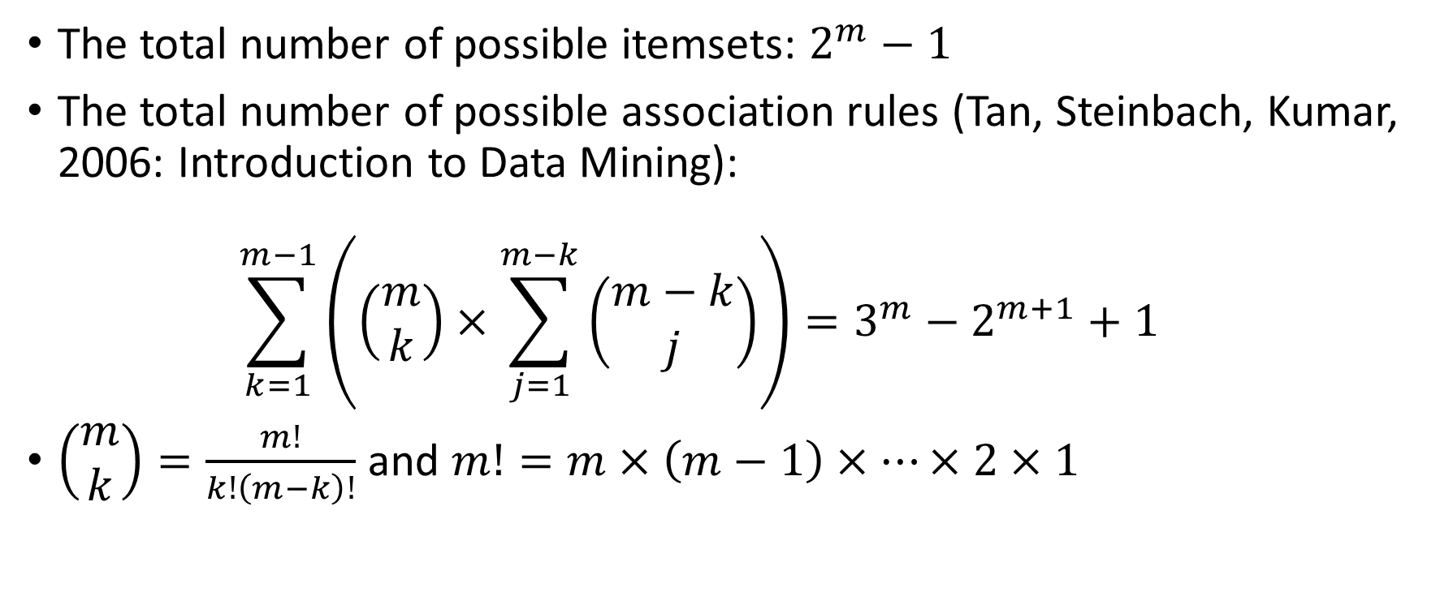
Maximum Number of Association Rules
The total number of possible itemsets: $2^{m}−1$
The total number of possible association rules (Tan, Steinbach, Kumar, 2006: Introduction to Data Mining): $\sum_{k=1}^{m−1}{\left(\left(\begin{matrix}m \\ k\end{matrix}\right)×\sum_{j=1}^{m−k}{\left(\begin{matrix}m−k \\ j\end{matrix}\right)}\right)=3^{m}−2^{m+1}+1}$
$\left(\begin{matrix}m \\ k\end{matrix}\right)=\frac{m!}{k!\left(m−k\right)!}$ and $m!=m×\left(m−1\right)×⋯×2×1$
Read Book for Proof

Slide 32
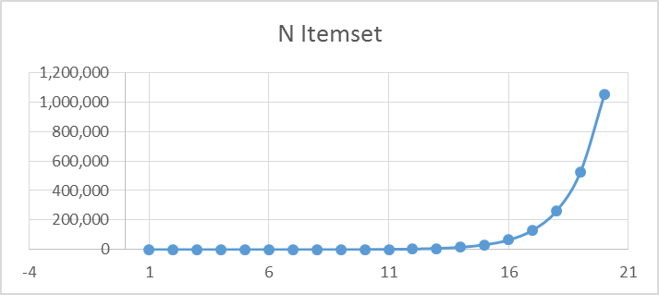
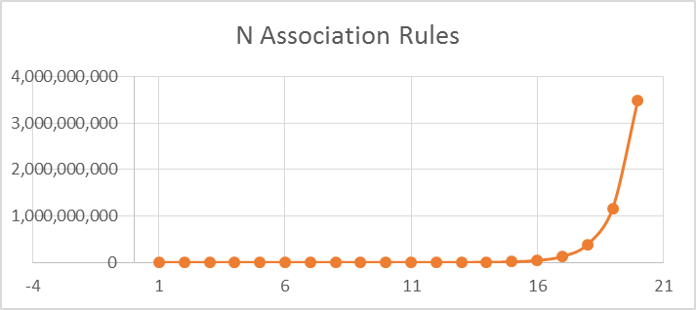
Maximum Number of Association Rules
m | N Itemset | N Association Rules
1 | 1 | 0
2 | 3 | 2
3 | 7 | 12
4 | 15 | 50
5 | 31 | 180
6 | 63 | 602
7 | 127 | 1,932
8 | 255 | 6,050
9 | 511 | 18,660
10 | 1,023 | 57,002
11 | 2,047 | 173,052
12 | 4,095 | 523,250
13 | 8,191 | 1,577,940
14 | 16,383 | 4,750,202
15 | 32,767 | 14,283,372
16 | 65,535 | 42,915,650
17 | 131,071 | 128,878,020
18 | 262,143 | 386,896,202
19 | 524,287 | 1,161,212,892
20 | 1,048,575 | 3,484,687,250

Slide 33
A Toy Example of Association Rules
Suppose a store sells only four items: A, B, C, and D
Transaction data for 10 customers
Since Association Rules discovery concerns whether an item occurs in a transaction, multiple occurrences of a single item (e.g., 3 Ds in customer 1) is no different from a single occurrence.

Slide 34
A Toy Example of Association Rules
Support for {A}:
Occurred in customers 1, 7, 8, 9
Equals 4/10 = 40%
Support for {B, D}:
Occurred in customers 1, 4, 6
Equals 3/10 = 30%
Support for {B, C, D}:
Occurred in customers 1, 6
Equals 2/10 = 20%

Slide 35
A Toy Example of Association Rules
RULE | SET_SIZE | EXP_CONF | CONF | SUPPORT | LIFT | COUNT | RULE
 | 1 | 40 |  | 40 |  | 4 | A
 | 1 | 50 |  | 50 |  | 5 | B
 | 1 | 40 |  | 40 |  | 4 | C
 | 1 | 70 |  | 70 |  | 7 | D
1 | 2 | 50 | 25 | 10 | 0.5 | 1 | A ==> B
2 | 2 | 40 | 50 | 20 | 1.25 | 2 | A ==> C
3 | 2 | 70 | 75 | 30 | 1.07 | 3 | A ==> D
4 | 2 | 40 | 20 | 10 | 0.5 | 1 | B ==> A
5 | 2 | 40 | 60 | 30 | 1.5 | 3 | B ==> C
6 | 2 | 70 | 60 | 30 | 0.86 | 3 | B ==> D
7 | 2 | 40 | 50 | 20 | 1.25 | 2 | C ==> A
8 | 2 | 50 | 75 | 30 | 1.5 | 3 | C ==> B
9 | 2 | 70 | 75 | 30 | 1.07 | 3 | C ==> D
10 | 2 | 40 | 42.86 | 30 | 1.07 | 3 | D ==> A
11 | 2 | 50 | 42.86 | 30 | 0.86 | 3 | D ==> B
12 | 2 | 40 | 42.86 | 30 | 1.07 | 3 | D ==> C
13 | 3 | 30 | 25 | 10 | 0.83 | 1 | A ==> B & C
14 | 3 | 30 | 25 | 10 | 0.83 | 1 | A ==> B & D
15 | 3 | 30 | 50 | 20 | 1.67 | 2 | A ==> C & D
RULE | SET_SIZE | EXP_CONF | CONF | SUPPORT | LIFT | COUNT | RULE
16 | 3 | 40 | 100 | 10 | 2.5 | 1 | A & B ==> C
17 | 3 | 70 | 100 | 10 | 1.43 | 1 | A & B ==> D
18 | 3 | 50 | 50 | 10 | 1 | 1 | A & C ==> B
19 | 3 | 70 | 100 | 20 | 1.43 | 2 | A & C ==> D
20 | 3 | 50 | 33.33 | 10 | 0.67 | 1 | A & D ==> B
21 | 3 | 40 | 66.67 | 20 | 1.67 | 2 | A & D ==> C
22 | 3 | 20 | 20 | 10 | 1 | 1 | B ==> A & C
23 | 3 | 30 | 20 | 10 | 0.67 | 1 | B ==> A & D
24 | 3 | 30 | 40 | 20 | 1.33 | 2 | B ==> C & D
25 | 3 | 40 | 33.33 | 10 | 0.83 | 1 | B & C ==> A
26 | 3 | 70 | 66.67 | 20 | 0.95 | 2 | B & C ==> D
27 | 3 | 40 | 33.33 | 10 | 0.83 | 1 | B & D ==> A
28 | 3 | 40 | 66.67 | 20 | 1.67 | 2 | B & D ==> C
29 | 3 | 10 | 25 | 10 | 2.5 | 1 | C ==> A & B
30 | 3 | 30 | 50 | 20 | 1.67 | 2 | C ==> A & D
31 | 3 | 30 | 50 | 20 | 1.67 | 2 | C ==> B & D
32 | 3 | 40 | 66.67 | 20 | 1.67 | 2 | C & D ==> A
33 | 3 | 50 | 66.67 | 20 | 1.33 | 2 | C & D ==> B
34 | 3 | 10 | 14.29 | 10 | 1.43 | 1 | D ==> A & B
35 | 3 | 20 | 28.57 | 20 | 1.43 | 2 | D ==> A & C
36 | 3 | 30 | 28.57 | 20 | 0.95 | 2 | D ==> B & C

Slide 36
A Toy Example of Association Rules
RULE | SET_SIZE | EXP_CONF | CONF | SUPPORT | LIFT | COUNT | RULE
29 | 3 | 10 | 25 | 10 | 2.5 | 1 | C ==> A & B
30 | 3 | 30 | 50 | 20 | 1.67 | 2 | C ==> A & D
31 | 3 | 30 | 50 | 20 | 1.67 | 2 | C ==> B & D
32 | 3 | 40 | 66.67 | 20 | 1.67 | 2 | C & D ==> A
33 | 3 | 50 | 66.67 | 20 | 1.33 | 2 | C & D ==> B
34 | 3 | 10 | 14.29 | 10 | 1.43 | 1 | D ==> A & B
35 | 3 | 20 | 28.57 | 20 | 1.43 | 2 | D ==> A & C
36 | 3 | 30 | 28.57 | 20 | 0.95 | 2 | D ==> B & C
37 | 4 | 20 | 25 | 10 | 1.25 | 1 | A ==> B & C & D
38 | 4 | 30 | 100 | 10 | 3.33 | 1 | A & B ==> C & D
39 | 4 | 70 | 100 | 10 | 1.43 | 1 | A & B & C ==> D
40 | 4 | 40 | 100 | 10 | 2.5 | 1 | A & B & D ==> C
41 | 4 | 30 | 50 | 10 | 1.67 | 1 | A & C ==> B & D
42 | 4 | 50 | 50 | 10 | 1 | 1 | A & C & D ==> B
43 | 4 | 30 | 33.33 | 10 | 1.11 | 1 | A & D ==> B & C
44 | 4 | 20 | 20 | 10 | 1 | 1 | B ==> A & C & D
45 | 4 | 30 | 33.33 | 10 | 1.11 | 1 | B & C ==> A & D
46 | 4 | 40 | 50 | 10 | 1.25 | 1 | B & C & D ==> A
47 | 4 | 20 | 33.33 | 10 | 1.67 | 1 | B & D ==> A & C
48 | 4 | 10 | 25 | 10 | 2.5 | 1 | C ==> A & B & D
49 | 4 | 10 | 33.33 | 10 | 3.33 | 1 | C & D ==> A & B
50 | 4 | 10 | 14.29 | 10 | 1.43 | 1 | D ==> A & B & C

Slide 37
Rule Searching Algorithm
Brute force type algorithm (i.e., listing all possible association rules) is inefficient (takes too long) and infeasible (not enough computer memory) when m is moderately large.
Need a smarter way to search for rules because:
We want to limit the number of items appeared in a rule, an antecedent, or a consequent
We are interested in rules whose supports and/or confidence are above a particular threshold
We are interested in rules that show significant lift

Slide 38
Apriori Algorithm
Apriori algorithm constrains the search space for rules by discovering frequent itemsets and only examining rules that are made up of frequent itemsets.
Apriori algorithm proceeds in two stages:
First, it identifies frequent itemsets in the data, and
Then it generates rules from the table of frequent itemsets.

Slide 39
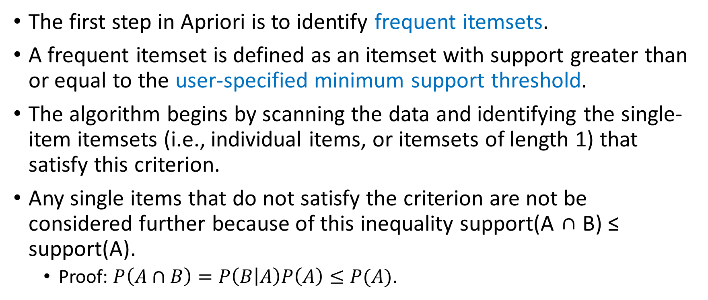
Apriori Algorithm: First Step
The first step in Apriori is to identify frequent itemsets.
A frequent itemset is defined as an itemset with support greater than or equal to the user-specified minimum support threshold.
The algorithm begins by scanning the data and identifying the single-item itemsets (i.e., individual items, or itemsets of length 1) that satisfy this criterion.
Any single items that do not satisfy the criterion are not be considered further because of this inequality support(A ∩ B) ≤ support(A).
Proof: $P\left(A∩B\right)=P\left(B | A\right)P\left(A\right)≤P(A)$.

Slide 40
Apriori Algorithm: Second Step
The second step is to select rules. For each frequent itemset L with length k > 1, the following procedure is applied:
Generate all observable rules from this itemset L.
For each generated rule, calculate the evaluation measure (e.g., rule confidence) for the rule.
If the evaluation measure is greater than the user-specified threshold, then add the rule to the rule table.

Slide 41
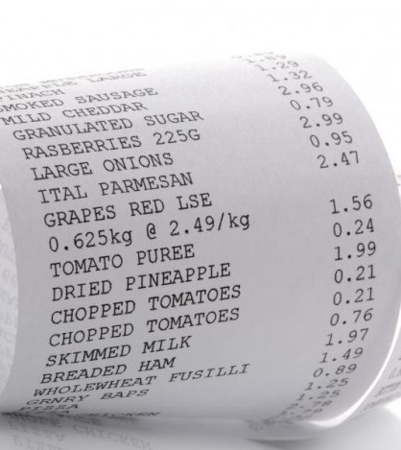
Summary: Input Transaction Data Structure
The input data should be in a transactional data structure
Sale Receipt format
Item List format.
Item Indicator format

Slide 42
Sale Receipt Format
Customer | Item
C1 | D
C1 | D
C1 | C
C1 | B
C1 | A
C1 | D
C1 | B
C1 | C
C2 | D
C3 | B
C4 | B
C4 | D
C4 | B
C4 | D
C5 | C
C5 | B
C6 | B
C6 | B
C6 | C
C6 | D
C6 | C
C7 | D
C7 | C
C7 | A
C8 | A
C9 | D
C9 | D
C9 | A
C10 | D
C10 | D
The input data table should contain these two fields.
The first field is the identifiers of customers
The second field is the identifiers of the items (or products) that are purchased by (or associated with) the customers.
Each customer has as many records as the number of items.
Each record is for each item purchased by the customer.
Commonly used format because the number of fields is fixed at two and the fields are stored as strings.

Slide 43
Item List Format
['D', 'D', 'C', 'B', 'A', 'D', 'B', 'C']
['D']
['B']
['B', 'D', 'B', 'D']
['C', 'B']
['B', 'B', 'C', 'D', 'C']
['D', 'C', 'A']
['A']
['D', 'D', 'A’]
['D', 'D']
Each customer has one record
The input data table should contain these two fields.
The first field contains the identifiers of customers
The second field is a list (or array) of the item identifiers.
Also, a common format but the second field requires special storage type (a list of strings with a variable number of strings)

Slide 44
Item Indicator Format
Each customer has one record
The number of fields is equal to one plus the number of distinct items.
The first field is the identifiers of customers
The second to the last fields are the Boolean values that indicate whether an item has been purchased.
A handy format for developing codes but requires more storages. It is because most customers will only purchase a handful of items.
A B C D
0 True True True True
1 False False False True
2 False False False True
3 False True False False
4 False True False True
5 False True True False
6 False True True True
7 True False True True
8 True False False False
9 True False False True

Slide 45
Summary: Preprocess Data
Duplicated items of a customer are removed.
The number of customers is known at this time.
The number of unique items is known at this time.
The number of unique items of each customer is also known at this time.

Slide 46
Summary: Algorithm Parameters
Max_k = Maximum size of itemset (i.e., the maximum k)
Min_S = Minimum Support Level
Min_C = Minimum Confidence Level

Slide 47
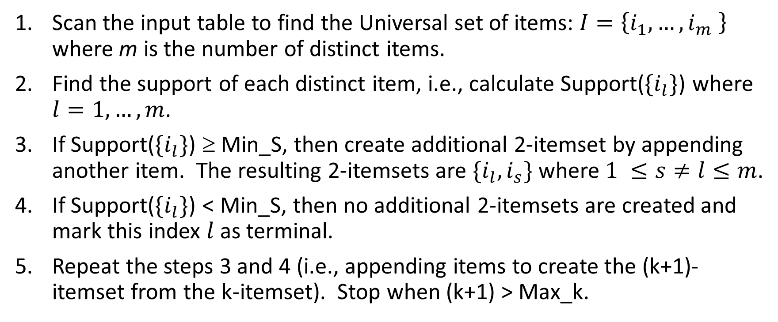
Summary: Find Frequent Itemset
Scan the input table to find the Universal set of items: $I=\left\{i_{1},…,i_{m} \right\}$ where m is the number of distinct items.
Find the support of each distinct item, i.e., calculate Support($\{i_{l}\}$) where $l=1,…,m$.
If Support($\{i_{l}\}$) ≥ Min_S, then create additional 2-itemset by appending another item. The resulting 2-itemsets are $\{i_{l},i_{s}\}$ where $1 ≤s≠l≤m$.
If Support($\{i_{l}\}$) < Min_S, then no additional 2-itemsets are created and mark this index $l$ as terminal.
Repeat the steps 3 and 4 (i.e., appending items to create the (k+1)- itemset from the k-itemset). Stop when (k+1) > Max_k.

Slide 48
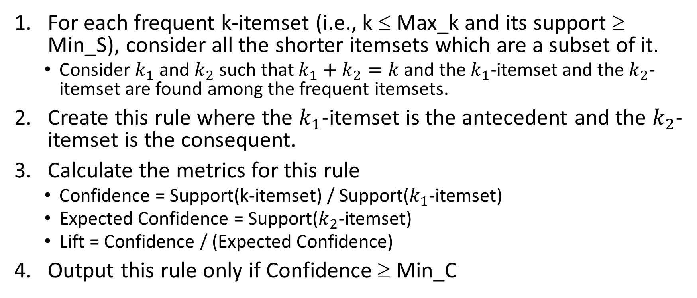
Summary: Find Rules
For each frequent k-itemset (i.e., k ≤ Max_k and its support ≥ Min_S), consider all the shorter itemsets which are a subset of it.
Consider $k_{1}$ and $k_{2}$ such that $k_{1}+k_{2}=k$ and the $k_{1}$-itemset and the $k_{2}$-itemset are found among the frequent itemsets.
Create this rule where the $k_{1}$-itemset is the antecedent and the $k_{2}$-itemset is the consequent.
Calculate the metrics for this rule
Confidence = Support(k-itemset) / Support($k_{1}$-itemset)
Expected Confidence = Support($k_{2}$-itemset)
Lift = Confidence / (Expected Confidence)
Output this rule only if Confidence ≥ Min_C

Slide 49
Apriori Algorithm Applied to the Toy Example
Support for {A}:
Occurred in customers 1, 7, 8, 9
Equals 4/10 = 40%
Support for {B, D}:
Occurred in customers 1, 4, 6
Equals 3/10 = 30%
Support for {B, C, D}:
Occurred in customers 1, 6
Equals 2/10 = 20%

Slide 50
Minimum Support Threshold = 0.5
Support(A) = 0.4, Support(B) = 0.5, Support(C) = 0.4, Support(D) = 0.7
If the Minimum Support Threshold = 0.5, then we can ignore all itemsets that contain A or C.
As a result, we only consider these itemsets: (B), (D), and (B,D).
Since Support(B & D) = 0.3, this 2-itemset (B,D) will also be ignored.
Only 1-itemset (B) and (D) will survive, but no association rules can be created from these 1-itemsets.

Slide 51
Minimum Support Threshold = 0.3
Support(A) = 0.4, Support(B) = 0.5, Support(C) = 0.4, Support(D) = 0.7
If the Minimum Support Threshold = 0.3, then all four 1-itemsets will survive.
The 2-itemsets (A,D), (B,C), (B,D)and (C,D) will be the final frequent itemsets
Create rules: B → D and D → B.
Conf(B → D) = Support(B & D) / Support(B) = 0.3 / 0.5 = 0.6
Conf(D → B) = Support(B & D) / Support(D) = 0.3 / 0.7 = 0.4285
If the Minimum Confidence Threshold is 0.5, then the rule D → B will be ignored.

Slide 52
Python Library for Apriori Algorithm
Install mlxtend from https://anaconda.org/conda-forge/mlxtend
Latest version is 0.18.0, released on November 25, 2020
The apriori(trainData, min_support=, max_len=, use_colnames=) function finds the frequent itemsets. See for details. http://rasbt.github.io/mlxtend/user_guide/frequent_patterns/Apriori/
The association_rules(frequent_itemsets, metric=‘’, min_threshold=) function generates the association rules. See http://rasbt.github.io/mlxtend/user_guide/frequent_patterns/association_rules/ for details.

Slide 53
Apriori Algorithm Applied to the Toy Example
Week 3 Association Rule.py
import pandas
ToyAssoc = pandas.read_csv('C:\\IIT\\Machine Learning\\Data\\AssociationRuleToyExample.csv', delimiter=',')
# Convert the Sale Receipt data to the Item List format
ListItem = ToyAssoc.groupby(['Customer'])['Item'].apply(list).values.tolist()
# Convert the Item List format to the Item Indicator format
from mlxtend.preprocessing import TransactionEncoder
te = TransactionEncoder()
te_ary = te.fit(ListItem).transform(ListItem)
ItemIndicator = pandas.DataFrame(te_ary, columns=te.columns_)
from mlxtend.frequent_patterns import apriori
from mlxtend.frequent_patterns import association_rules
# Find the frequent itemsets
frequent_itemsets = apriori(ItemIndicator, min_support = 0.3, max_len = 2, use_colnames = True)
# Discover the association rules
assoc_rules = association_rules(frequent_itemsets, metric = "confidence", min_threshold = 0.5)

Slide 54
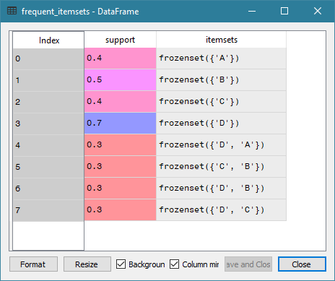
Apriori Algorithm Applied to the Toy Example
Found 8 itemsets whose support is 0.3 or higher
1-itemset
{A}, {B}, {C}, and {D}
2-itemset
{A, D}, {B, C}, {B, D}, and {C, D}

Slide 55
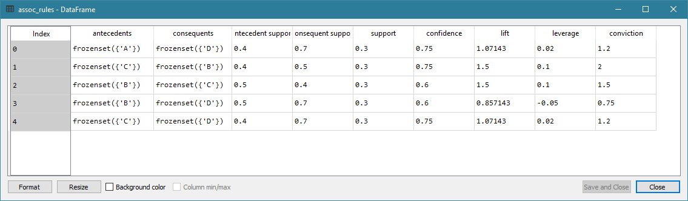
Apriori Algorithm Applied to the Toy Example
Note: Frozen set is just an immutable version of a Python set object.

Slide 56
Choice of Parameters
What is the maximum size of itemset?
What is the minimum Support?
What is the minimum Confidence?
A too high value takes a long time to get all the itemsets
A too low value risks missing some interesting rules

Slide 57
Maximum Size of Itemset
Calculate the number of items purchased by each customer
Create a frequency table of the results from (1)
Consider the median number of items purchased
Choose a lower number if the median is still too high

Slide 58
Minimum Support and Confidence
If resources permit, try lower Support and Confidence thresholds.
Try threshold = 0.01 (i.e., 1%)
Plot Support versus Confidence (i.e., Support on the vertical axis and Confidence on the horizontal axis)
Optionally make the size of marker proportional to Lift
Determine the practical thresholds for Support and Confidence
Use your analytical judgment to choose rules whose Confidence are above your comfort level, to draw a boundary to separate rules according to their Support.

Slide 59
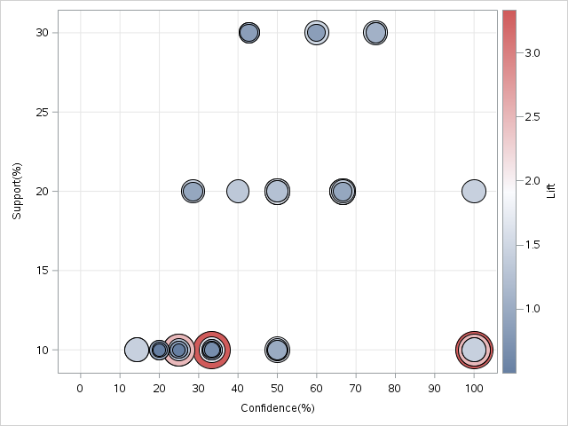
Scatterplot of Support vs. Confidence
Credible and Common Rules
Highly Credible, though Rare, Rules
Gray Area
Accidental Rules That Cannot Be Trusted

Slide 60
Imaginary Store Market Basket Example
Our imaginary store sales the following items: bananas, bologna, bread, buns, butter, cereal, cheese, chips, eggs, hotdogs, mayo, milk, mustard, oranges, pickles, and soda.
We have recorded transactions of 995 customers in this CSV file: imaginary_Store.csv. This CSV file has 7,037 rows of observations and two variables.
The variables are:
Customer: A unique identifier of a customer
Item: Item purchased by the customer

Slide 61
Imaginary Store Association Rules
Week 3 Imaginary Store Association Rule.py
# Load the necessarty libraries
from mlxtend.preprocessing import TransactionEncoder
import pandas
Imaginary_Store = pandas.read_csv('C:\\IIT\\Machine Learning\\Data\\Imaginary_Store.csv', delimiter=',')
# Convert the Sale Receipt data to the Item List format
ListItem = Imaginary_Store.groupby(['Customer'])['Item'].apply(list).values.tolist()
# Convert the Item List format to the Item Indicator format
te = TransactionEncoder()
te_ary = te.fit(ListItem).transform(ListItem)
ItemIndicator = pandas.DataFrame(te_ary, columns=te.columns_)
# Calculate the frequency table of number of customers per item
nCustomerPurchase = Imaginary_Store.groupby('Item').size()
freqTable = pandas.Series.sort_index(pandas.Series.value_counts(nCustomerPurchase))
# Calculate the frequency table of number of items purchase
nItemPurchase = Imaginary_Store.groupby('Customer').size()
freqTable = pandas.Series.sort_index(pandas.Series.value_counts(nItemPurchase))

Slide 62
Number of Customs Who Bought Item
Item | Frequency | Support
Chips | 698 | 0.702
Cheese | 696 | 0.699
Cereal | 639 | 0.642
Butter | 583 | 0.586
Buns | 571 | 0.574
Bread | 560 | 0.563
Bologna | 512 | 0.515
Bananas | 467 | 0.469
Eggs | 458 | 0.460
Hotdogs | 432 | 0.434
Mayo | 397 | 0.399
Milk | 341 | 0.343
Mustard | 248 | 0.249
Oranges | 220 | 0.221
Pickles | 129 | 0.130
Soda | 86 | 0.086
Since duplicated items in a customer’s basket are ignored, then the Frequency is the number of customers who bought that item.
For example, 698 customers have Chips in their basket. This means Support{Chips} = 0.702
Since including additional items will only decrease the Support, this suggests that the maximum support we can have is 0.702.
Week 3 Imaginary Store Association Rule.py

Slide 63
Recommended Maximum Size of Itemset
Read this frequency table like there are 28 customers who purchased 2 distinct items in their baskets
The median number of distinct items is 7.
So we set the maximum size of itemset to be 7.
Without additional information, we set the minimum Support to 0.01 and the minimum Confidence to 0.5
Found 53,516 rules
Item | Frequency
2 | 28
3 | 26
4 | 95
5 | 95
6 | 175
7 | 136
8 | 167
9 | 108
10 | 101
11 | 44
12 | 17
13 | 2
14 | 1
Week 3 Imaginary Store Association Rule.py

Slide 64
Imaginary Store Association Rules
Week 3 Imaginary Store Association Rule.py
from mlxtend.frequent_patterns import apriori
from mlxtend.frequent_patterns import association_rules
# Find the frequent itemsets
frequent_itemsets = apriori(ItemIndicator, min_support = 0.01, max_len = 7, use_colnames = True)
# Discover the association rules
assoc_rules = association_rules(frequent_itemsets, metric = "confidence", min_threshold = 0.5)
import matplotlib.pyplot as plt
plt.figure(figsize=(6,4))
plt.scatter(assoc_rules['confidence'], assoc_rules['support'], s = assoc_rules['lift'])
plt.grid(True)
plt.xlabel("Confidence")
plt.ylabel("Support")
plt.show()
# Find the frequent itemsets
frequent_itemsets = apriori(ItemIndicator, min_support = 0.1, max_len = 7, use_colnames = True)
# Discover the association rules
assoc_rules = association_rules(frequent_itemsets, metric = "confidence", min_threshold = 0.8)

Slide 65
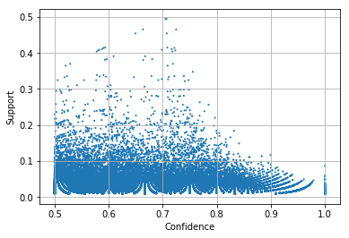
Support versus Confidence
Relatively fewer rules have Support > 0.3
We can set an aggressive Confidence threshold
Try minimum Support = 0.1 and minimum Confidence = 0.8.

Slide 66
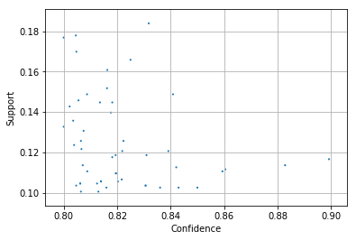
Support versus Confidence
There are 51 rules where Support > 0.1 and Confidence > 0.8
The Lift values vary between 1.14 to 1.37 with a median of 1.168

Slide 67
Rules with a Particular Consequent
Suppose you are promoting Cereal. You want to study the purchase behavior that, with high confidence, leads to buying Cereal only.
In other words, you want the Consequent to contain Cereal only.
# Show rules that have the 'CEREAL' consquent
import numpy
Cereal_Consequent_Rule = assoc_rules[numpy.isin(assoc_rules["consequents"].values, {"Cereal"})]

Slide 68
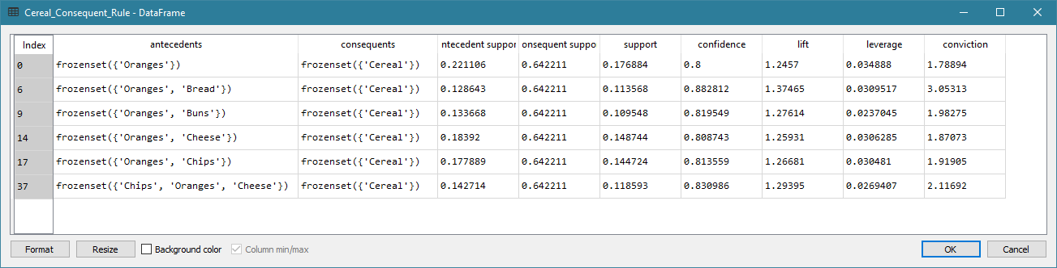
Rules with a “Cereal” Consequent

Slide 69
Rules with a Particular Antecedent
Suppose you want to study what else people buy if they already bought Oranges.
In other words, you want the Antecedent to contain Oranges.
# Show rules that have the 'Oranges' antecedent
antecedent = assoc_rules["antecedents"]
selectAntecedent = numpy.ones((assoc_rules.shape[0], 1), dtype=bool)
i = 0
for f in antecedent:
selectAntecedent[i,0] = "Oranges" in f
i = i + 1
Orange_Antecedent_Rule = assoc_rules[selectAntecedent]

Slide 70
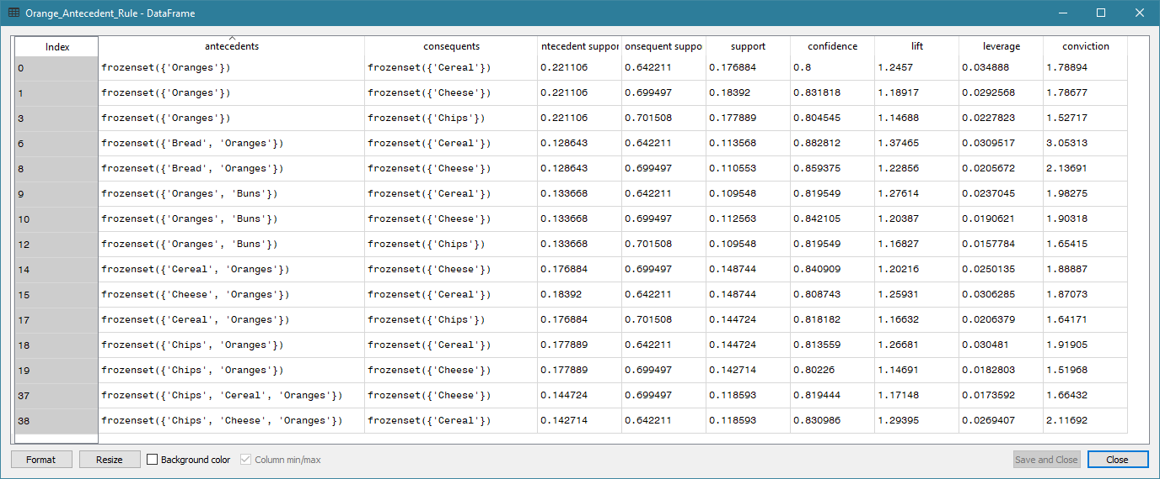
Rules that Contain “Oranges” in Antecedent

Slide 71
Reflection
Association Rules are easy to understand.
Association Rules have practical meanings.
Association Rules can be used to make business decisions.
Association Rules are developed based on the Bayes’ Theorem.
Apriori Algorithm makes it practical to generate Association Rules.
Set the Minimum Support and Minimum Confidence wisely to get rules that matter.
Drill down on rules with selected Antecedents and Consequents.

Slide 72
Preparation For Week 4
Read Chapter 4 of the Machine Learning book, if you can
https://scikit-learn.org/stable/modules/clustering.html#clustering
Ask yourself:
Why do you need to read this chapter?
What problems can I apply the algorithms in this chapter?

Slide 73

Special Arrangement for February 11, 2021
February 12, 2021 is the Chinese New Year Day of Ox
February 11, 2021 is the Chinese New Year Eve
Class will not meet in real-time on February 11, 2021
Dr. Lam will pre-record the Week 4 lecture
Week 4 lecture recording will be available before 6:45 PM on February 11, 2021
Please direct all questions about this special arrangement to Dr. Lam

